Slide 1

System Security
Submitted By :
Bhavya Mittal 2100910100058
Aryan Chaturvedi 2100910100044
B.Tech CSE

Slide 2
About Project
System security refers to the set of measures and practices designed to protect computer systems, networks, and data from unauthorized access, theft, damage, or other malicious activities. It encompasses various aspects of digital security, such as access control, authentication, encryption, firewalls, intrusion detection and prevention, malware protection, and security auditing.

Slide 3
There are several types of security threats that computer systems can face, including viruses, worms, Trojans, spyware, adware, and ransomware. These threats can compromise the confidentiality, integrity, and availability of sensitive information and cause significant damage to the system.
To ensure system security, organizations typically implement various security policies, procedures, and tools. This includes setting up strong passwords and authentication mechanisms, applying software updates and patches, using antivirus software and firewalls, and limiting access to sensitive data and resources to authorized personnel only.

Slide 4
Additionally, security professionals may perform security assessments and penetration testing to identify vulnerabilities and weaknesses in the system and develop strategies to mitigate these risks. The field of system security is constantly evolving, with new threats and vulnerabilities emerging all the time, and security experts must stay up-to-date with the latest developments and best practices to protect systems effectively.

Slide 5



Technology Used
1. C++
2. VS Code(IDE)

Slide 6
About C++
C++ is a general-purpose, object-oriented programming language designed for systems programming and widely used in the development of operating systems, compilers, and database systems. It is an extension of the C programming language, and supports features such as classes, templates, and exception handling.

Slide 7
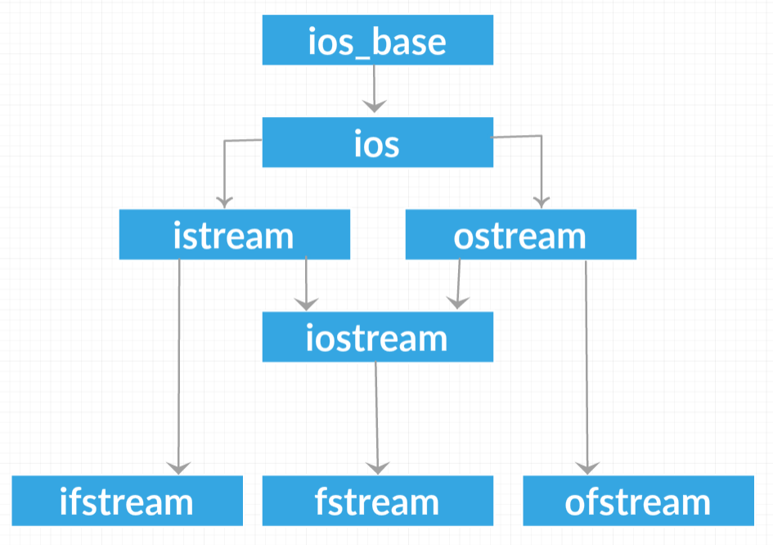
C++ file handling involves reading from and writing to files using standard input/output streams or file stream classes such as ifstream , ofstream , fstream. This enables more complex file operations, such as reading and writing binary data, and requires proper error handling to prevent unexpected behavior.

Slide 8
About VS Code
Visual Studio Code (VS Code) is a free, open-source code editor developed by Microsoft. It supports a variety of programming languages and features, such as syntax highlighting, auto-completion, debugging, and Git integration. It is widely used by developers for its customizable user interface and extensive library of extensions.

Slide 9

Why This Project?
With increase in usage of internet and computers, user data is now more vulnerable for data breaches.

Slide 10

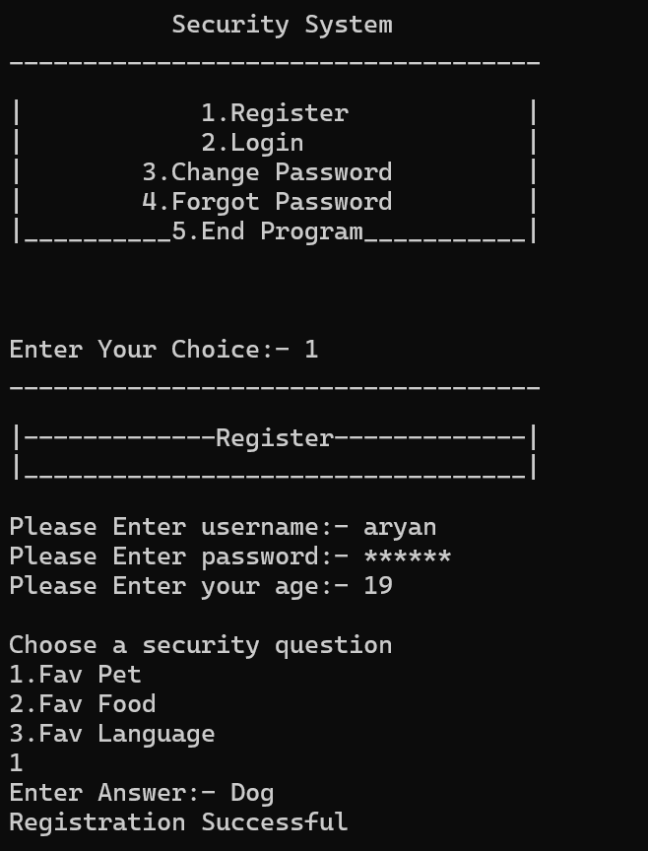
My Project

Slide 11
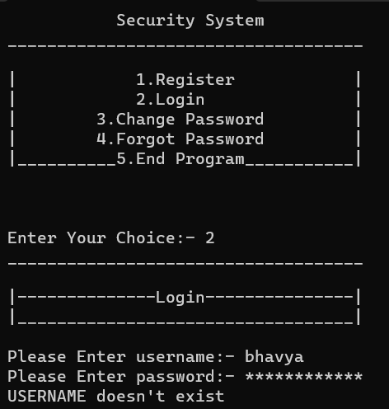
My Project

Slide 12

Objective
To create a simple console-based user registration and login system in C++ language that allows users to register their credentials and securely login to their account, and stores user information in a file. The system should provide a user-friendly interface that allows users to easily register and login, while also implementing robust security measures to protect user data. Additionally, the system should be designed to handle errors gracefully and provide informative feedback to users in case of any issues

Slide 13


